Slide 1
Evaluating Agents
CS6960 MultiModal LLM Agents
Kenneth Marino
Slide credits: Shuyan Zhou, Li Fei-Fei, Jia Deng, Larry Zitnick, Tatsunori Hashimoto, others

Slide 2
Announcements
HW2 due today
You have a few more late days to complete
Projects
Due Friday
If you don’t have an assigned group on Canvas to submit, let us know
All info now in the Canvas Assignment
In-class activity Thursday to help you double-check before you submit

Slide 3
Any Questions

Slide 4
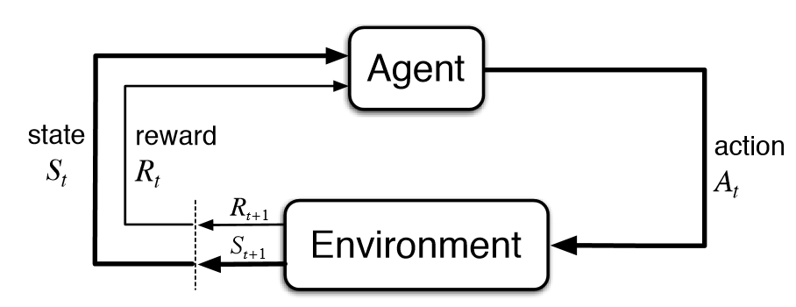

We have a VLM Agent
Input: text/images
VLM
Output: text (usually)

Slide 5

We have a VLM Agent
Input: text/images
VLM
Output: text (usually)

Slide 6
We have a VLM Agent
Input: text/images
VLM
Output: text (usually)
How good is it?
Is it better than other AI Agents?

Slide 7
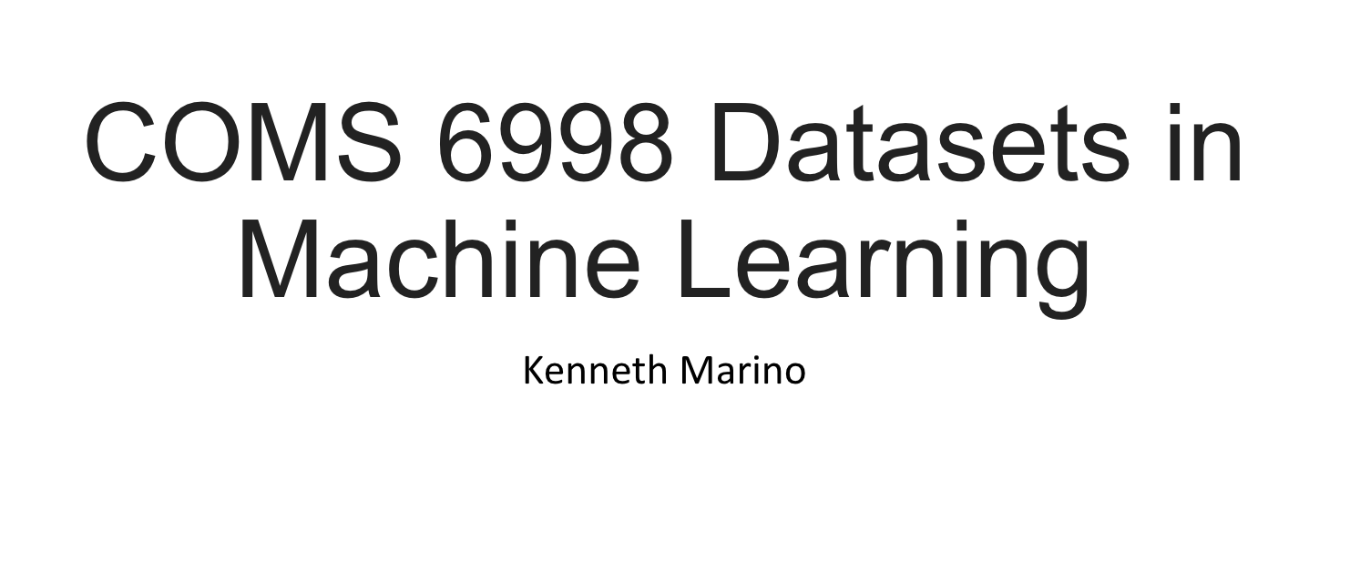
My first special topics class

Slide 8
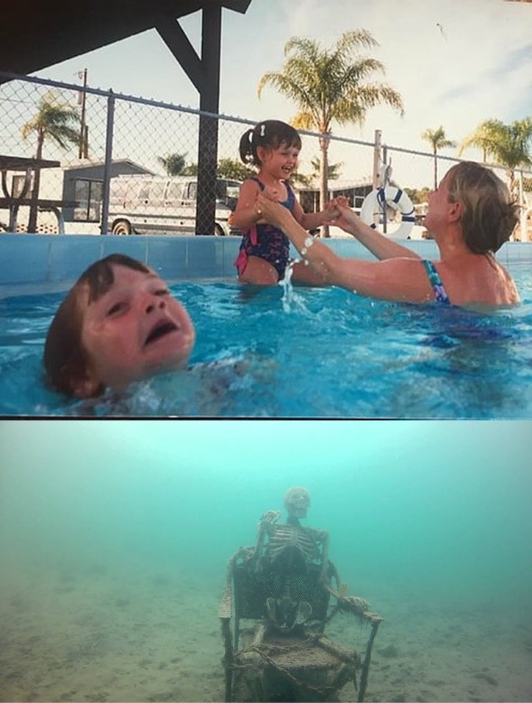
Datasets/Evaluations often overlooked
Models
Datasets are often overshadowed by models and methods
Often the most influential driver of progress in Machine Learning, Computer Vision and NLP.
Overview the important topics in datasets
Dataset analysis
Collection
Evaluation
Dataset bias
Ethics
Cover the most influential datasets
Datasets

Slide 9
What does an evaluation do?
Let’s us compare different models
Measure/drive progress in a field
Understand behaviors/limitations

Slide 10
Good case study: ImageNet

Slide 11




Where have we been? Where are we going?
Li Fei-Fei & Jia Deng
https://image-net.org/static_files/files/imagenet_ilsvrc2017_v1.0.pdf

Slide 12
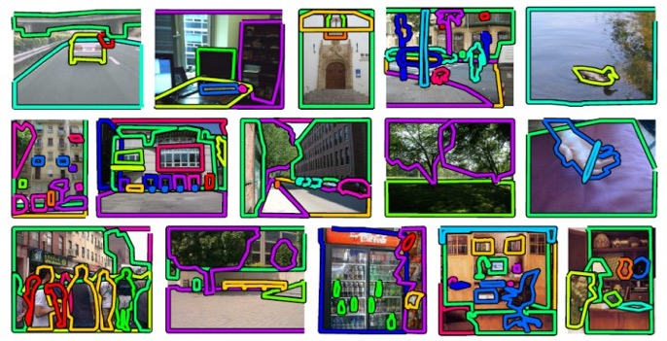
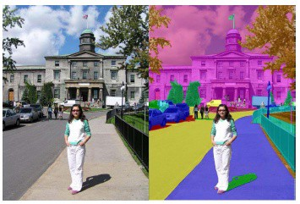
While Others Targeted Detail…
LabelMe
Per-Object Regions and Labels Russell et al, 2005
Lotus Hill
Hand-Traced Parse Trees Yao et al, 2007

Slide 13


…They Targeted Scale
SUN, 131K
[Xiao et al. ‘10]
LabelMe, 37K
[Russell et al. ’07]
15M
PASCAL VOC, 30K
[Everingham et al. ’06-’12]
[Deng et al. ’09]
Caltech101, 9K
[Fei-Fei, Fergus, Perona, ‘03]

Slide 14
An Emphasis on Community and Achievement
Large Scale Visual Recognition Challenge (ILSVRC 2010-2017)

Slide 15
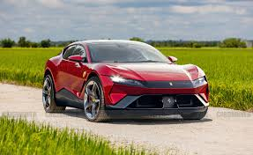
ImageNet Evaluation
Output class
Classifier
“Car”
Metric: Accuracy
Does predicted class match ground truth label?

Slide 16

Participation and Performance
172
157
123
81
35
29
2010 2011
Number of Entries
2012
2013
2014
2015
2016

Slide 17


Participation and Performance
0.28
172
157
123
81
35 ₂₉
0.03
2010 2011
Number of Entries
2012
2013
2014
2015
2016
Classification Errors (top-5)

Slide 18

Participation and Performance
0.28
0.66
172
157
123
81
35 ₂₉
0.23
0.03
2010 2011
Number of Entries
2012
2013
2014
2015 2016
Average Precision For Object Detection
Classification Errors (top-5)

Slide 19

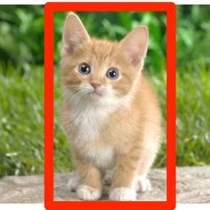

Outcomes
Breakthroughs in object recognition
Machine learning advances and changes dramatically
ImageNet becomes a benchmark

Slide 20
What if measure of success less clear?

Slide 21
What if measure of success less clear?
Describe everything that is in this image

Slide 22
Case Study: Image Captioning

Slide 23

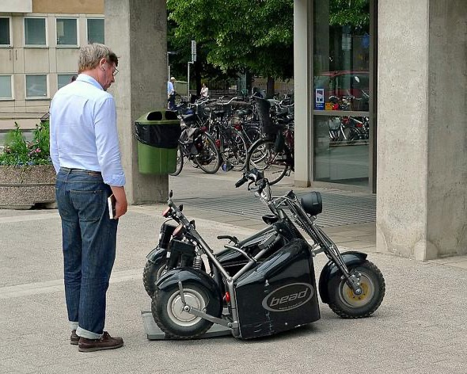
160,000 images
5 captions per image
A man checking out a parked black scooter.
A person standing near a small motorcycle on a city street.
A man in a white shirt is looking at a three wheeled motorcycle.
A man looks down at two low riding motor bikes.
A guy staring at a weird looking bike.
Slide credit: Larry Zitnick

Slide 24
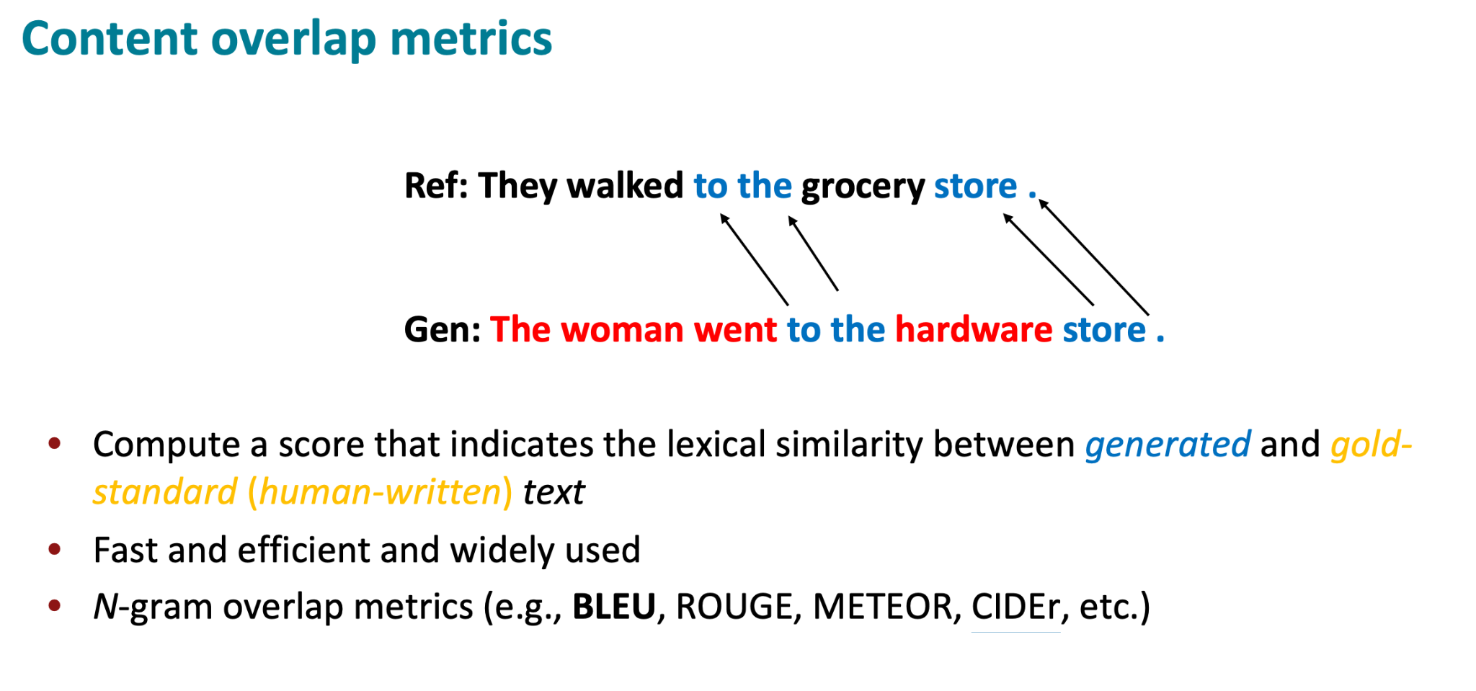
Evaluation:

Slide 25
Timeline
August, 2014
120,000 images x 5 captions per image =
600,000 captions

Slide 26




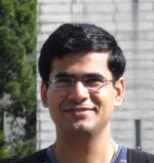
The Great Freak Out
August, 2014
October
Yeesss!
It works!!!
I can’t believe it works!!!
Sweet!!!
This is awesome!!!

Slide 27
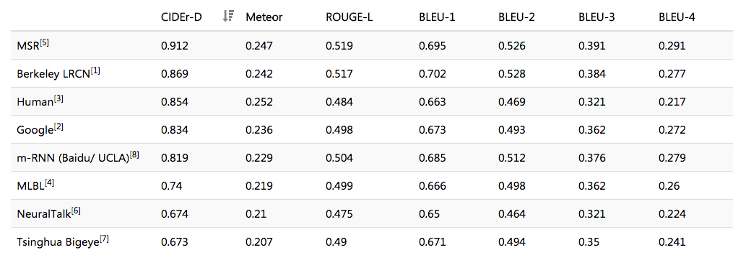
The Reckoning
August, 2014
October
April, 2015

Slide 28
The Enlightening
August, 2014
October
April
June, 2015
How do humans rate the captions?

Slide 29
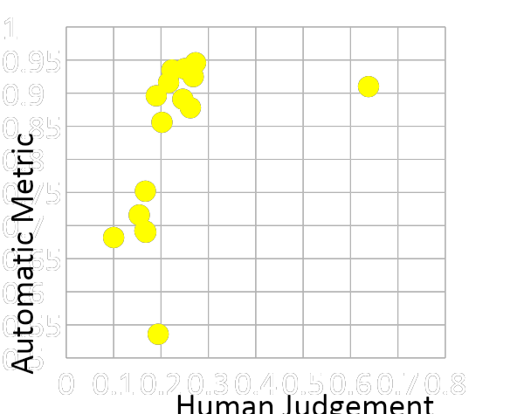
Evaluation
COCO Caption Challenge

Slide 30
Evaluation
COCO Caption Challenge
Brno University

Slide 31
Evaluation
COCO Caption Challenge
Humans

Slide 32
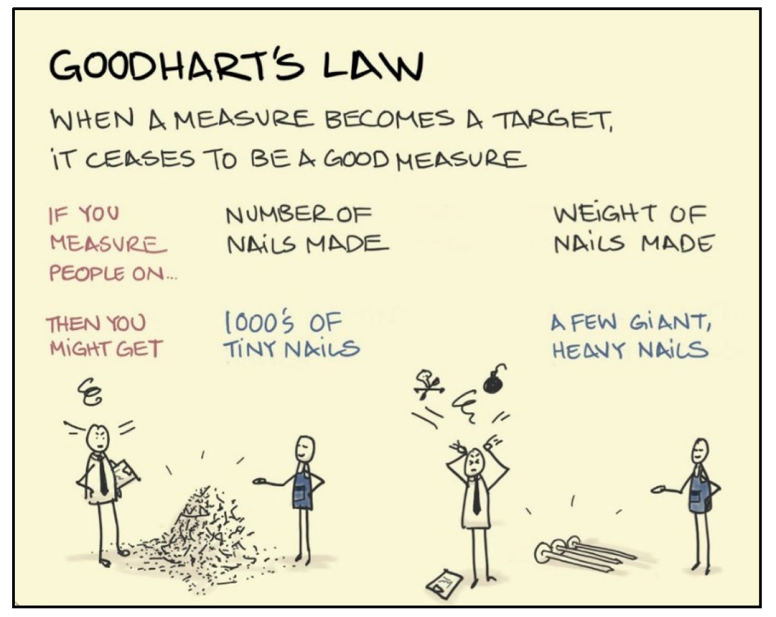
Goodhart’s Law

Slide 33
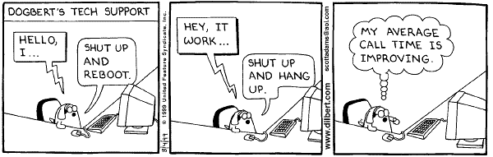
Goodhart’s Law

Slide 34
What does an evaluation do?
Let’s us compare different models
Measure/drive progress in a field
Understand behaviors/limitations

Slide 35
What we want in an agent evaluation
It accurately tracks what humans care about
Measures broad abilities of agent models capabilities
Automatic - Can be done without additional human effort
Reproducible - Consistently produces same outcome
Ranks models - better models do better than worse ones

Slide 36
What we want in an agent evaluation
It accurately tracks what humans care about
Measures broad abilities of agent models capabilities
Automatic - Can be done without additional human effort
Reproducible - Consistently produces same outcome
Ranks models - better models do better than worse ones
Doing all of these is kind of impossible

Slide 37
Option 1
It accurately tracks what humans care about
Measures broad abilities of agent models capabilities
Automatic - Can be done without additional human effort
Reproducible - Consistently produces same outcome
Ranks models - better models do better than worse ones
Just get humans to evaluate it

Slide 38
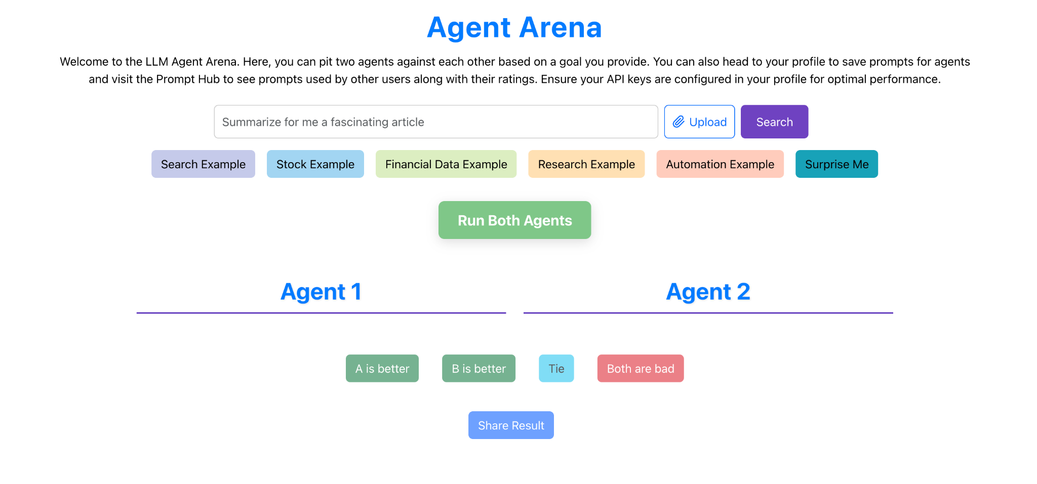
Clever ways of getting humans to eval

Slide 39
Option 2 - Proxy/Automatic
It accurately tracks what humans care about
Measures broad abilities of agent models capabilities
Automatic - Can be done without additional human effort
Reproducible - Consistently produces same outcome
Ranks models - better models do better than worse ones
Extremely task specific
May only be doable in some envs
Very difficult to get right

Slide 40
Atari: Use the final reward
Does atari score capture everything we care about?
Input: text/images
VLM
Output: text (usually)

Slide 41
Option 3 - LLM/Agent as judge
It accurately tracks what humans care about
Measures broad abilities of agent models capabilities
Automatic - Can be done without additional human effort
Reproducible - Consistently produces same outcome
Ranks models - better models do better than worse ones

Slide 42
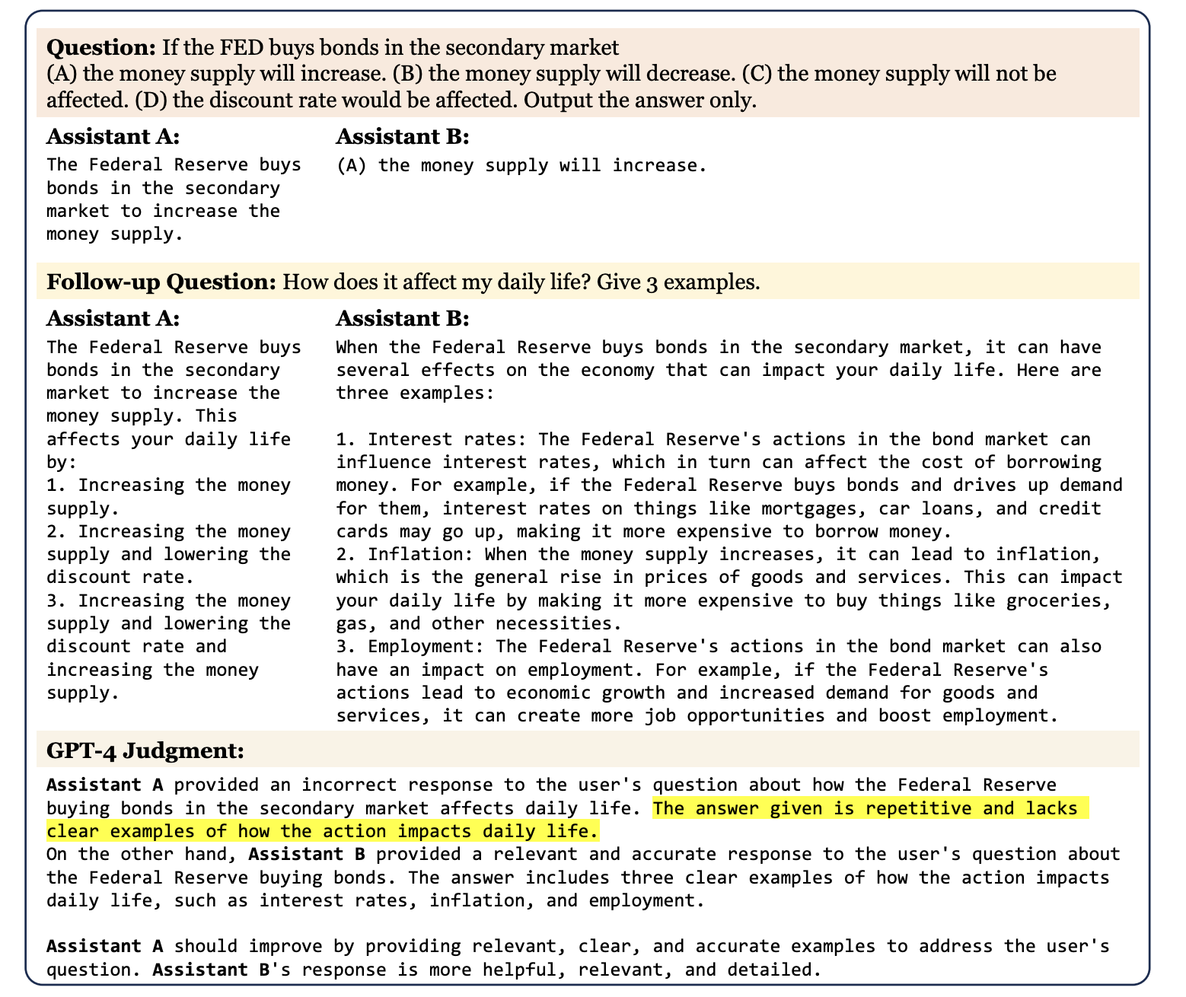
LLM as Judge
See student presentation this week

Slide 43
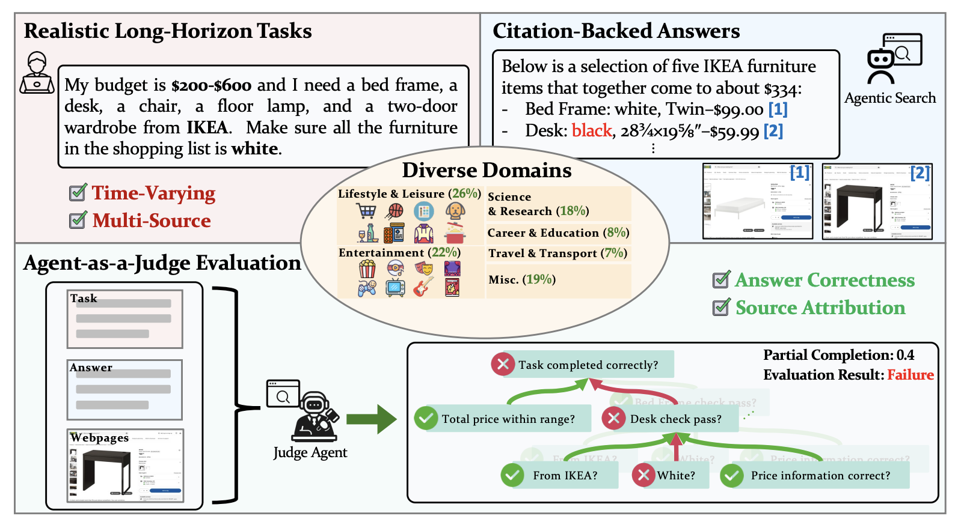
Extension: Agent as Judge
Mind2Web 2: Evaluating Agentic Search with Agent-as-a-Judge

Slide 44
Other evaluation problems
Data leakage - are your tasks already in the training set?
Agent tasks are complicated difficult
Agent tasks are often ambiguous
Agents can often find “shortcuts” in evaluations
Is accuracy the right measure (cost? partial completion?)

Slide 45
As you think about your projects
Need to think about evaluation
What is important to measure for your system?
What evaluation can you do in a short time
You probably have to compromise somewhere

Slide 46

Any Questions
Questions

Slide 47
Now for the presentations!

